Slide 1

Data Driven Education
Discussion Forum Subteam
Presentation 1 - 09/24/2025

Slide 2





Meet the Team
Zilu Zhu
Project Manager
Clara Murray
Literature Reviewer
Harikesh Tambareni
ML Engineer
Saloni Agshiker
Data Scientist
Ethan Lu
ML+Data Engineer

Slide 3
Introduction
Online Discussion platform is crucial in modern education and digital studies.
Ed Discussion and EdX: widely used online discussion forum
  EdX offers Massive Open Online Courses (MOOCs)
  enables students and instructors to interact
  discuss course materials asynchronously
What are some unique characteristics of Online Discussion Forums?
What to do to utilize Online Discussion platforms better?
Improve the whole education experience
Notes:
Zilu
Online Discussion platform is crucial in modern education. Ed Discussion, a widely used online discussion forum, enables students and instructors to interact and discuss course materials asynchronously.
How is online discussion forum different from traditional classrooms and what could we do to better utilize this technology becomes a questions to all educators.
In our study, we plan to utilize Ed Discussion data to analyze patterns of student participation, identify common learning challenges, and optimize instructor interventions in order to improve the whole education experience.

Slide 4
Research Questions
How to combine sentiment analysis and cognitive presences to provide insights into student engagement and attitudes toward the course?
How to use machine learning techniques to predict students' success in the course based on their discussion engagements?
What is the best way to present discussion analytics to instructors in an actionable and user-friendly dashboard?
Notes:
Zilu

Slide 5
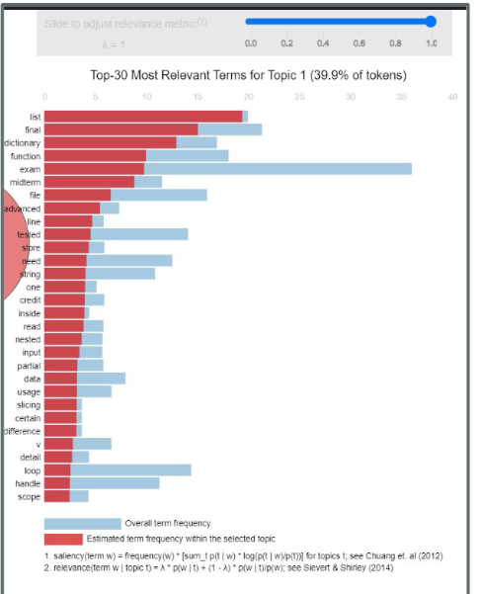
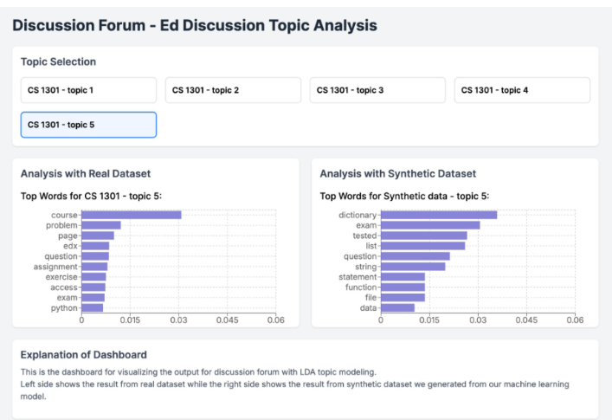
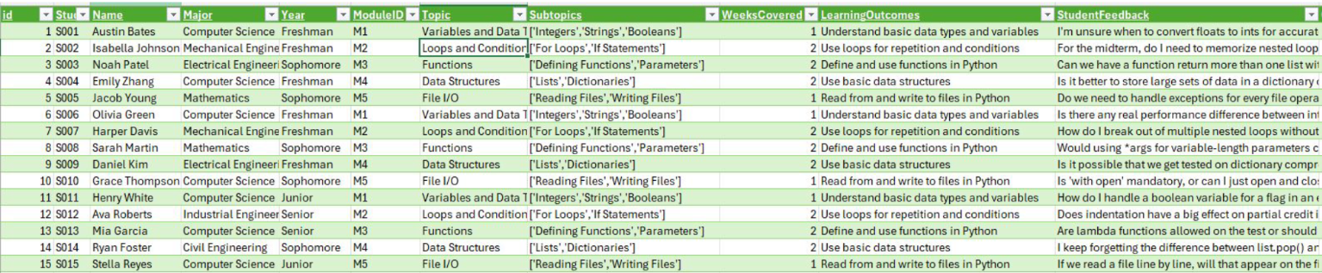
Spring 2025 Recap:
Data Science:
Classification
  Focus on text > metadata classification
  EdX DF dataset
Analysis and Interpretation
  Latent-Dirichlet Allocation (LDA) to measure token-frequency
  Gensim, PyLDAvis, and Matplotlib
Machine Learning:
Outcome
  Developed a synthetic CS 1301 dataset using OpenAI's o1 model
  Topic distribution over time
Mock-up React dashboard
Notes:
ETHAN

Slide 6

Goals for the Semester
Enhance analysis of online discussion forum data
  Data-driven insights, ML models, and more
  Develop a dashboard
Explore sentiment analysis with cognitive presences in addition to topic modeling
  Utilizing BERT
Build a model to analyze students' grades relations to online engagement

Slide 7
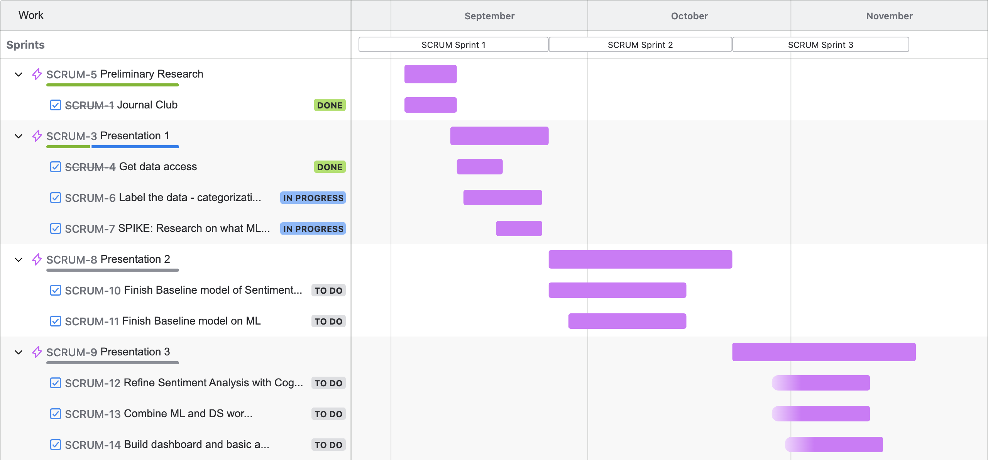
Project Timeline
Jira - For task tracking and management
Notes:
Zilu

Slide 8
Data Science

Slide 9
Goals & Timeline for the Semester
Spring 2025
January – February:
  Learn data cleaning & processing techniques
February – April:
  Create text-analysis models for sentiment analysis via LDA & TF-IDF
April – May:
  Revamp dashboard from last semesters
Fall 2025
August – mid-October:
  Continue exploring text-analysis models for sentiment analysis
  BERT - Google’s NLP model that can learn a wide breadth of tasks relating to language
Mid-October – December:
  Analyze dataset to understand student levels of cognitive presence
December:
  Using insights, revamp dashboard from last semesters
Weeks 1-2
Weeks 3-4
Weeks 5-6
Weeks 7-8
Weeks 9-10
Feb 3-17
Feb 17 - March 3
March 3-24
March 24 - April 7
April 7-19
Research text-analysis models
Clean & pre-process data
Create LDA model
Process & analyze results
Fine-tune BERT or TF-IDF
Clean & pre-process dataset
Analyze & compare results from both models
Design & create dashboard
Notes:
SALONI

Slide 10
Metrics/Data We’re Using/ Why this Data is Relevant
Hybrid approach using preprocessed and processed edX data
~18.5k data entries
Tradeoff assessment
Determine from results the more useful data
BERT - Deep learning model
Sprint 1: Benchmark
Label the first thousand data points based on five declared, sentiment categories
Sprint 2: Scaling
Create data pipeline optimized for BERT to produce sentiment analysis results at scale
Fine-tune model for predictive analysis
Sprint 3: Interpret
Integrate data viz tools into user-friendly dashboard + deployment?
Notes:
ETHAN

Slide 11
Machine Learning

Slide 12
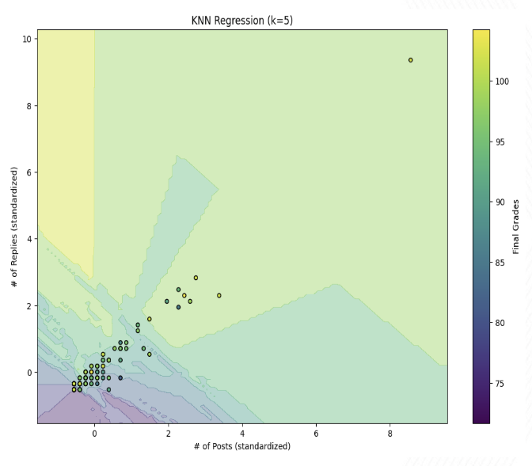
Spring Recap:
KNN Model:
K-Nearest Neighbor Model uses k-nearest points to find to predict the response variable with n factors
We tuned this model and found the lowest error when using k=5
Replying to posts reflects more positively on grades than creating new posts
Notes:
Harikesh

Slide 13
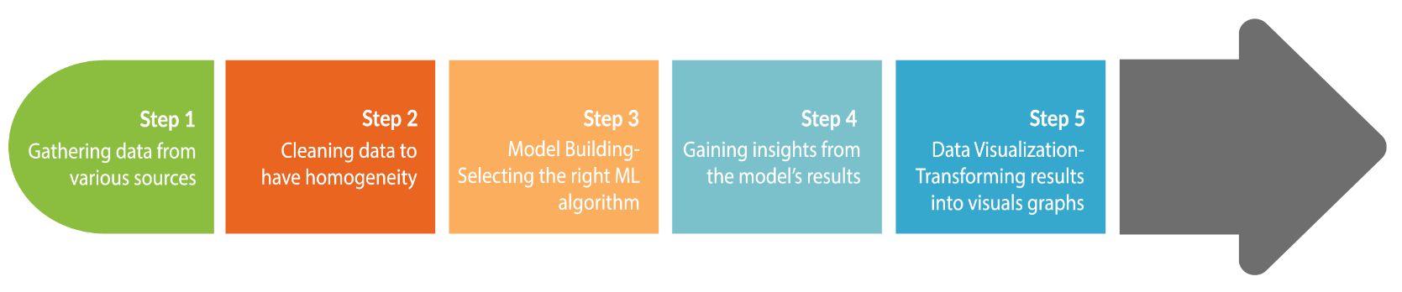
Goals for the Semester
Using data from CS1301 2017 & 2018
  Join grades, forum post, and forum thread datasets with queries
  Clean null/blank information
Process data to create a bi-modal student behaviors model
  Our target variable is student grades and we want to identify which forum behaviors predict academic success
  We want to study 2 topics:
    Text embeddings (semantics, etc.)
    Time-series (frequency, timing in sem, etc.)
Once identifying which behaviors are key after fusing our bi-modal model, we can create visualizations of those traits and their correlation to grades

Slide 14
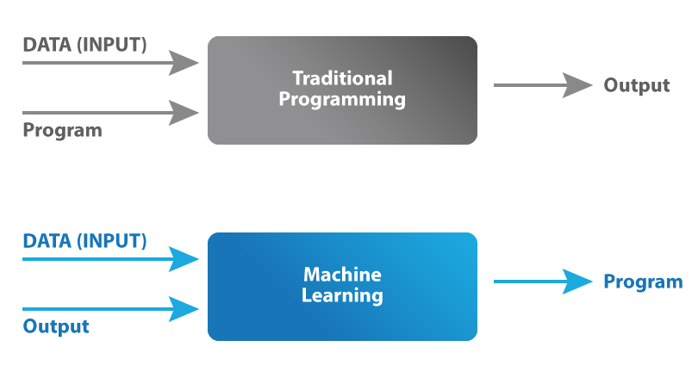
Progress So Far:
Identified usable data for this model
Concluded the two best modalities to consider when assessing student behaviors with our dataset
Decided to use LSTM ML function for time-series modality and Transformer ML function for semantic modality
Started writing queries to join 3 tables where necessary for end model to process

Slide 15
Literature Review
Notes:
Clara

Slide 16
Literature Review:
Goals:
Understand how sentiment analysis and cognitive presence overlap to provide insights on student engagement and attitudes towards the course
Explore prior applications of learning analytics dashboards to identify best practices for integrating data visualization into actionable tools for instructors.
Examine engagement metrics and labeling strategies from past studies to guide how we categorize sentiment and measure student participation in our project.
Body of Knowledge:
“Analyzing Learning Sentiments on a MOOC Discussion Forum Through Epistemic Network Analysis.” (Jianhui Yu, 2025)
  Examines how sentiments evolve over time in MOOCs, and their relationships with performance and topic.
“From Concept to Classroom: Developing Instructor Dashboards through Human-Centered Design.” (Alzoubi, Dana, et al., 2024)
  Describes a human-centered design approach for instructor dashboards.
Notes:
Clara

Slide 17
Literature Takeaways:
“Analyzing Learning Sentiments on a MOOC Discussion Forum Through Epistemic Network Analysis.” (Jianhui Yu, 2025)
Epistemic network analysis (ENA) can map co-occurrence of different sentiment states
Identify variation in sentiment patterns by performance group
Take into account sentiment frequency and changes in those over time.
"From Concept to Classroom: Developing Instructor Dashboards through Human-Centered Design.” (Alzoubi, Dana, et al., 2024)
Human-centered design should be a priority
Focus on providing actionable insights over raw data
Refine the dashboard with instructor input over multiple iterations
Ensure usability: complex results should be translated into simple engagement metrics
Notes:
Clara

Slide 18
Conclusion
Improve course design and refine teaching strategies
Provide inclusive learning environments
Personalize learning for foreseeable weakness
Promote student’s engagements and grades
Ensure a more responsive and adaptive online learning experience.
Notes:
Zilu

Slide 19
Citations
Alzoubi, Dana, et al. “From Concept to Classroom: Developing Instructor Dashboards through Human-Centered Design.” Computers and Education Open, vol. 7, Dec. 2024, Article 100234, doi:10.1016/j.caeo.2024.100234.
Yu, Jianhui. “Analyzing Learning Sentiments on a MOOC Discussion Forum Through Epistemic Network Analysis.” The International Review of Research in Open and Distributed Learning, vol. 26, no. 1, Mar. 2025, pp. 197-215, doi:10.19173/irrodl.v26i1.7965.

Slide 20
Q&A
Thanks for listening!

